Slide 1
Critical Questions for Creating an Interactive Learning Event

Slide 2
Creating an interactive learning event requires asking and answering certain questions before actual development or programming begins.
Foundational questions
Practical questions
Scoring and assessment questions
Gameplay questions

Slide 3
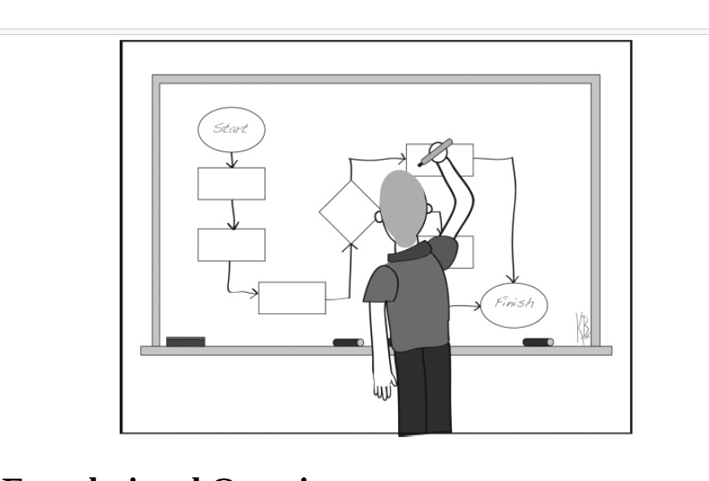

Slide 4
Foundational Questions
What Is the Real Problem?
Lack of customer service
Quality issues
Time problems (processes taking too long, not enough time to complete customer orders, etc.)
Safety issues
Lack of performance

Slide 5
Students/ learners perspective questions
Deeper engagement of students
Application of theory
Increase motivation
Better tracking of understanding

Slide 6
What Are the Learners Not Doing?
Find out requirements for the learners on they can improve their performance
Identify the problems.

Slide 7
What Is the Desired Outcome?
What is the desired outcome of the ILE? What do you want the learner to be able to do or to know after interacting with the ILE?

Slide 8
What Is Needed to Achieve Success?
What does the learner/player need to know to achieve the outcome of the ILE?
Likes basic requirements to interact with ILE
If the player could already achieve the desired outcome quickly and easily, an ILE would not be necessary.

Slide 9
What Are the Tasks of the ILE?
What are the tasks that must be demonstrated to achieve the outcome?
Answer questions
Apply content
Drag items to the correct place
Explore an area
Identify information
Apply values

Slide 10
Practical Questions
The first set of questions dealt with the issue of what needs to be taught and the type of outcomes that can be expected from the ILE.

Slide 11
Who Are the Learners?
First we have to identify the learners
Technical knowledge
Familiarity with games/simulations/gamification
Reading level
Knowledge level of subject matter

Slide 12
What Are the Logistics?
When will the ILE be played?
How often will the ILE be played?
On what type of device will the ILE be played?
What amount of time is available to play the ILE?
When will the ILE be played?
Where will the ILE be played?

Slide 13
What Are the Technical Issues?
How will the ILE be delivered (HTML 5, Flash, on a mobile device, laptop)?
What information needs to go to the learning management system?
What type of artwork is required? Can it be 2-D or do you need 3-D or just simple badges?
Is a password needed?
How often can learners access the ILE?
What do we do if there is a technical problem?

Slide 14
Scoring and Assessment Questions
These questions provide information to inform the development of scoring and assessment of the ILE.

Slide 16
What Should the Measurement Criteria Be?
Time
Accuracy
Correctness
Knowledge of all the elements

Slide 17
What Drives the ILE?
Will the game be driven by points, levels, badges, or some other method

Slide 18
What Is the Rationale Behind Scoring?
Describe the point and scoring system and rationale behind the system.

Slide 19
Does the Scoring Match Learner Outcomes?
Do the ILE activities match learner outcomes?

Slide 20
Game Play Questions
“What are the learners doing during the interactive learning event?”

Slide 21
What Are the Learners Doing?
Allocating resources
Building
Chasing/being chased
Collecting
Discriminating
Dodging
Exploring
Matching
Problem solving
Racing
Role playing
Stealing
Strategizing

Slide 22
How Do You Win or Lose?
What is the winning state of the ILE?

